Slide 1
Patient Management System
Course: Data Structure & Algorithm
Mr. Sohail-2024-uobsac-1362
Mr. Wilayat Ali-2024-uobsac-1407
Mr. Waqar Ahmed-2024-uobsac-1367
Mr. Shabbir Hussain-2024-uobsac-1407

Slide 2

Introduction
A system to manage hospital patients efficiently.
Digitizes patient registration, appointments, and billing.
Improves accuracy and saves time for hospital staff.

Slide 3

project Overview
Digital management of patient information Handles registration, appointments, and records Centralized platform for all departments.
1
Reduces human error and boosts coordination.
2

Slide 4

Important and Objective
Improve hospital efficiency and accuracy.
Minimize paperwork.
Provide quick access to patient data.
Secure and compliant with healthcare standards.
1
2
3
4

Slide 5


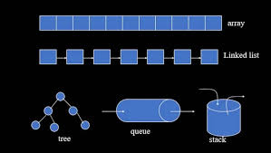


Technologies Used
</innovation_pipeline>
Python (Flask Framework)
Data Structures: Linked List, Queue, Stack, Tree
HTML, CSS, Bootstrap for Frontend
CSV files for data storage

Slide 6
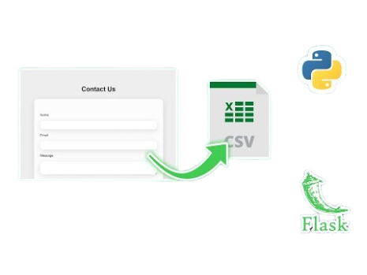
System Architecture
User → Flask Web App → Data Structures → CSV Storage
1
1
Follows MVC (Model-View-Controller) pattern.

Slide 7
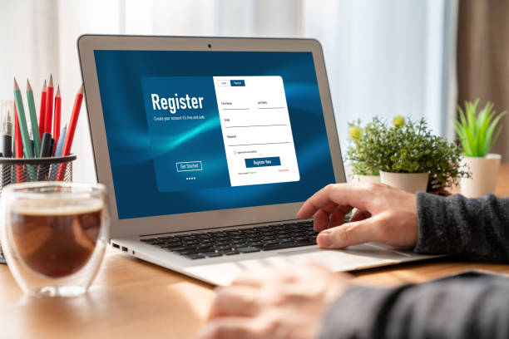
Features 1
Register Patient
Add new patient details (name, age, disease, doctor).
Stored using Linked List and Tree.
Input validation ensures data accuracy.

Slide 8
Features 2
View All Patient
Displays all registered patients from Linked List.
Allows update and delete operations.
User-friendly table layout.

Slide 9

Features 3
Schedule Appointment
Uses Queue structure for appointments.
'Next Appointment' serves (dequeues) patient.
Ensures fair scheduling order.

Slide 10

Feature 4
Billing Calculation
Calculates total bill: base + tests + medicines.
Flask instantly displays calculated bill.
Automatically resets after serving each patient.

Slide 11

Feature 5
Search by Doctors
Uses Binary Search Tree (BST).
Enhances data retrieval speed.
Quickly finds patients assigned to specific doctors.

Slide 12


Save Data
</innovation_pipeline>
Save all patient and appointment data to CSV.
Automatically loads saved data at startup.

Slide 13
Data Structure summary
Linked List – Store patients
Queue – Handle appointments
Stack – Undo actions
Tree – Search by doctor
CSV – Persistent storage

Slide 14

Conclusions
Simplifies hospital management process.
Integrates Python with Data Structures.
Demonstrates teamwork, design, and problem-solving.

Slide 15

Future Improvements
Add login system for doctors/staff.
Use MySQL or SQLite database.
Generate PDF receipts for bills.
Mobile responsive design.

Slide 16
Thank you
Do you have any questions?

